Slide 1

Repaying the Credit
By pooja nm

Slide 2
Contents:
Objectives
Visualization of graphs
Observations
Suggestions

Slide 3
Objectives:
Gold Atlantis is credit proving firm ,After receiving credit application it approves or disapproves application based on applicants' profile. here we need To identify those applicants who have lower probability of becoming a defaulter.
To improve business of firm.

Slide 4
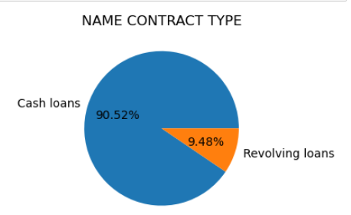
Exploring Contract type
Nearly 90000 or 90.50% applicants have cash loans

Slide 5
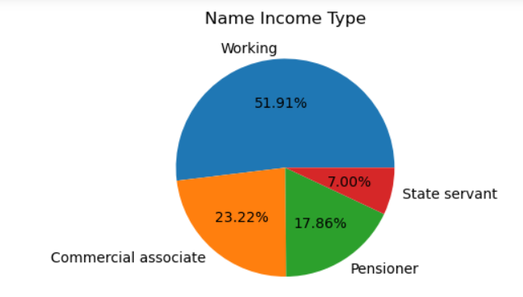
Exploring Income type
51.90% of applicants have income type as working

Slide 6
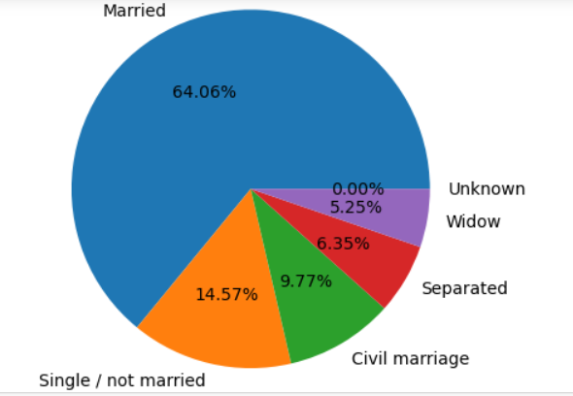
Exploring family status
64.06% of applicants have family status Married

Slide 7
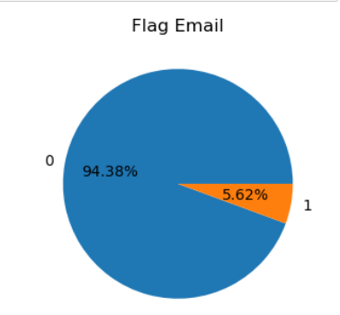
Exploring Email
94.38% of applicants have provided Email id.

Slide 8
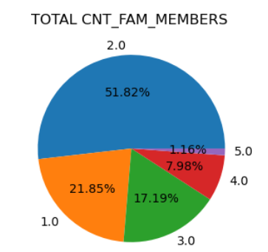
Exploring Count of Family Members
51.72% of applicants have family member count 2.

Slide 9
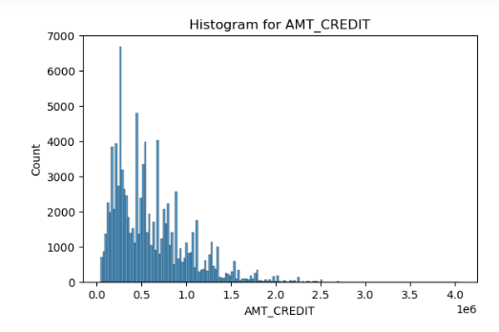
Exploring Amount Credit
6000 applicants have AMT_CREDIT 0.3

Slide 10
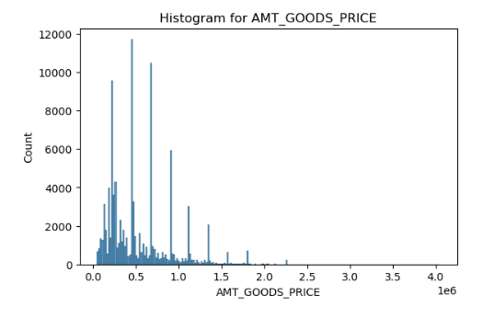
Exploring Amount goods price
1200 applicants have AMT_GOODS_PRICE 0.5

Slide 11
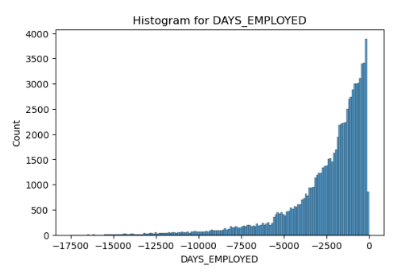
Exploring Days Employed
Most of the applicants have DAYS EMPLOYED between 2500 to 0

Slide 12
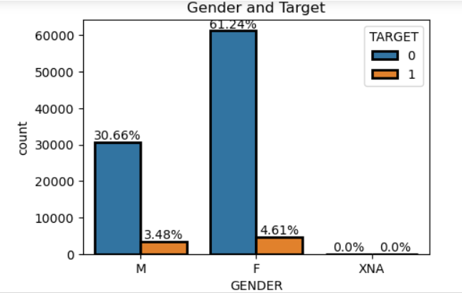
Which Gender have lower probability to become defaulter?
Female Applicants have lower probability to .become defaulter

Slide 13
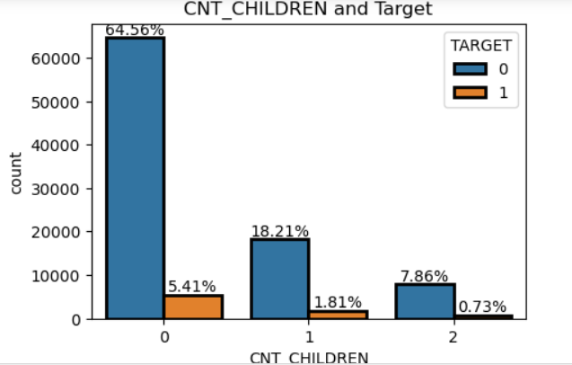
How Many Children count have lower probability to become defaulter?
Applicants having 0 children have lower probability to become defaulter.

Slide 14
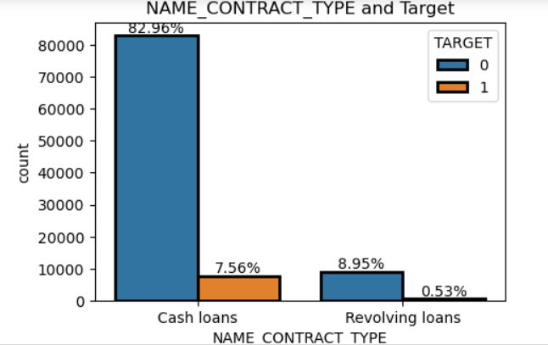
Which Kind of loan have lower probability to become defaulter?
Applicants having cash loans have lower probability to become defaulter.

Slide 15
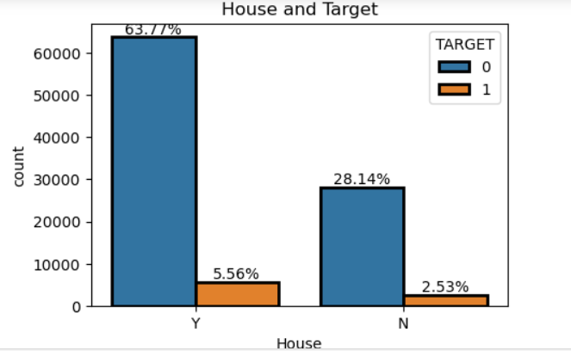
Does owning House have lower probability to become defaulter?
Applicants who owns House has lower probability to become defaulter

Slide 16
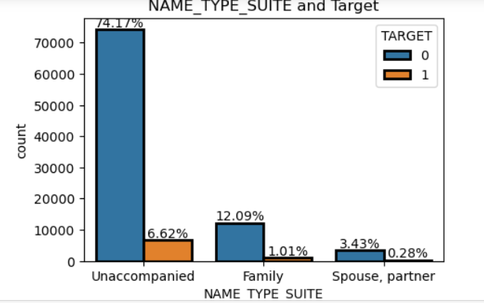
Does applicants accompanied by Whom has lower probability to become defaulter?
Applicants who are unaccompanied has lower probability to become defaulter.

Slide 17
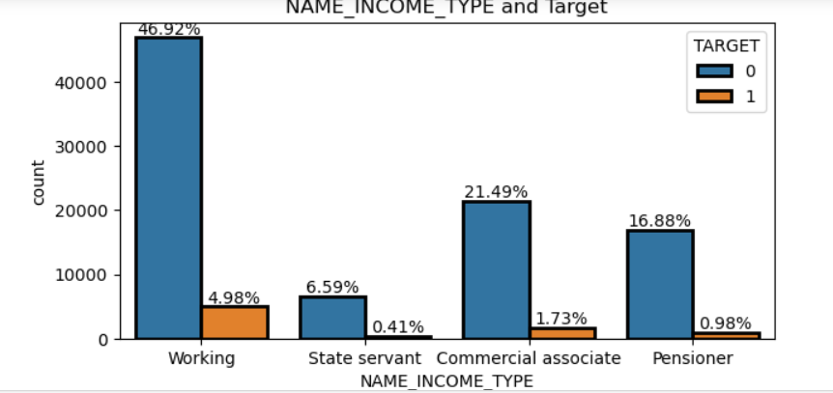
What should be the Income type of applicant for non defaulter?
Applicants who are having income type as Working , Commercial associate , Pensioner has lower probability to become defaulter.

Slide 18
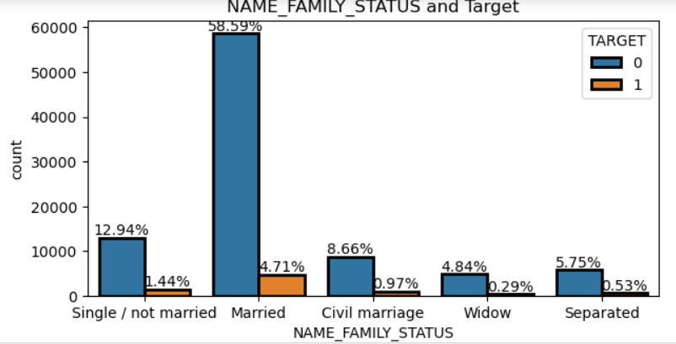
What should be family status of Applicants who have low probability to become defaulter?
Applicants whose family status is Married has low probability to become defaulter.

Slide 19
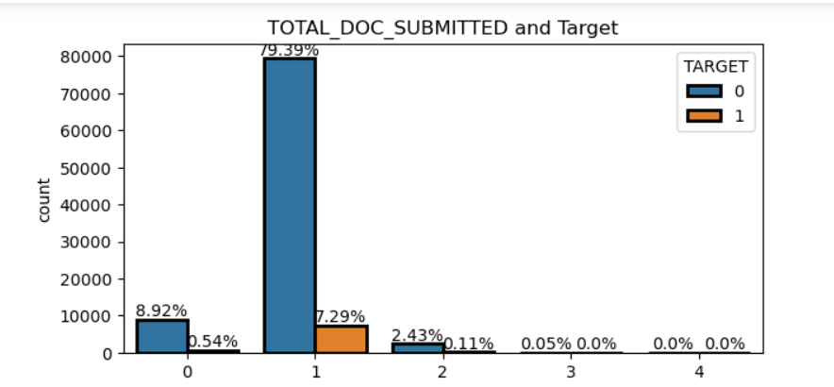
How many Documents has to be submitted to become non defaulter?
Applicants who submits 1 document has low probability to become defaulter.

Slide 20
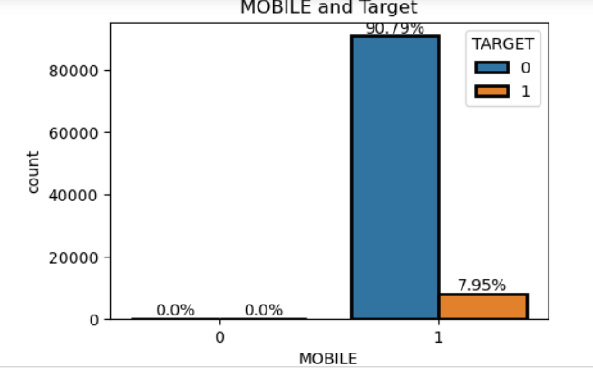
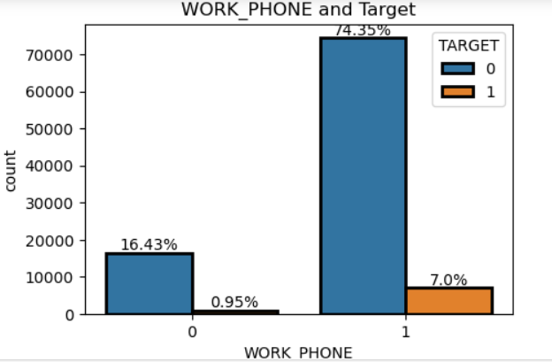
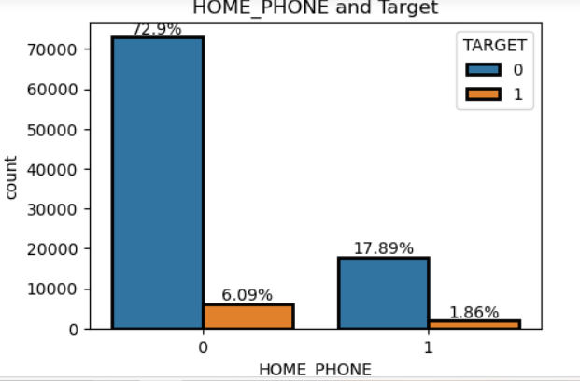
Should applicant provide Mobile, work phone, home phone number?
Applicants who has Provided Mobile Number, Home phone & Work phone number has low probability to become defaulter

Slide 21
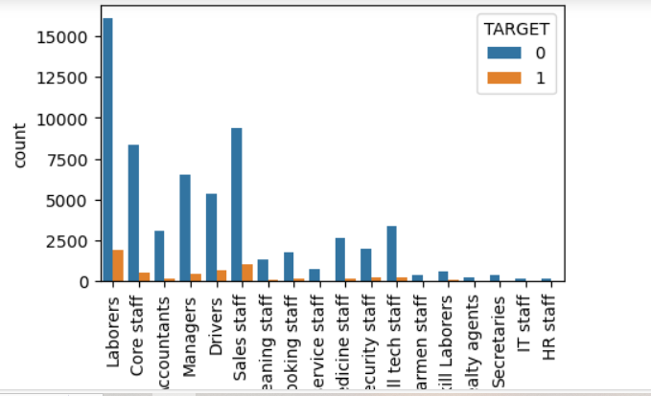
What should be OCCUPATION TYPE of non defaulter?
Applicants whose OCCUPATION TYPE is Laborer , core staff, Accountent, manager, driver, sales staff has low probability to become defaulter.

Slide 22
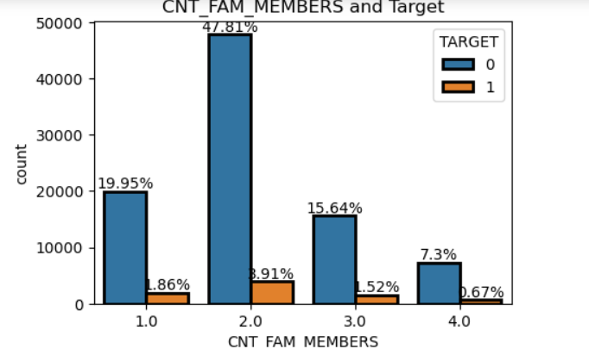
What should be the count of Family members who has lower probability to become defaulter?
Applicants whose Count of Family Members is 2 has low probability to become defaulter.

Slide 23
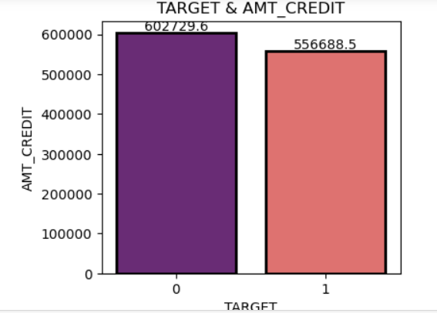
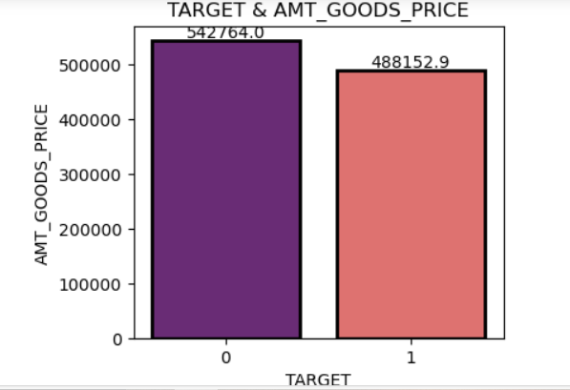
How much should be Amount credit , Amount goods price of applicant who has low probability to be defaulter?
Applicant whose Average AMT_GOODS_PRICE is 542764 & Average Amount credit 542764 & has low probability to become defaulter.

Slide 24
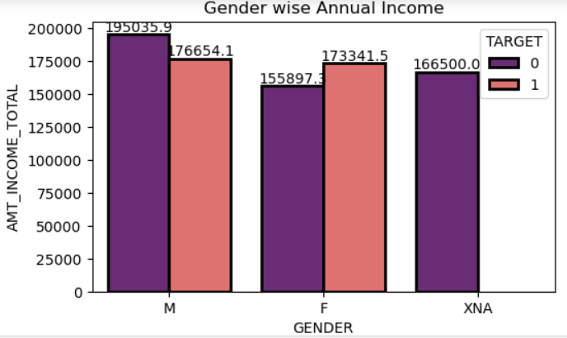
What should be the Annual Income of male & Female applicants to become non defaulter?
Male Applicant whose Average Annual Income of is 195035 and female Applicant whose Average Annual income is 155897 has low probability to become defaulter.

Slide 25
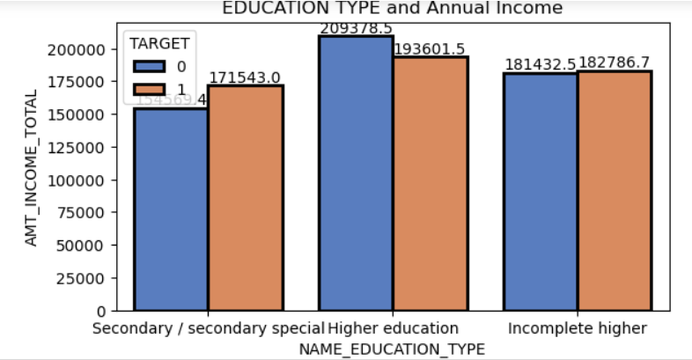
Which education type has high income & low probability to become defaulter?
Applicant whose education type is Higher education has Average Annual Income of 209378,has low probability to become defaulter.

Slide 26
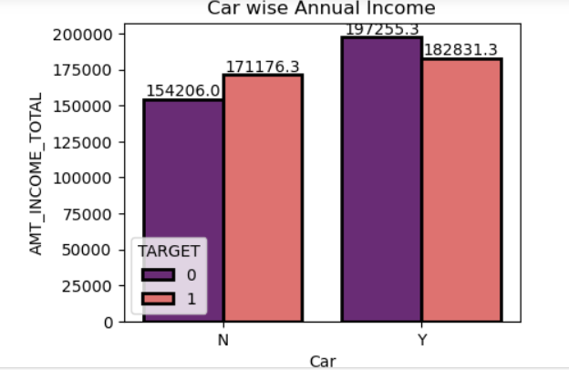
Does owning Car have lower probability to become defaulter and what should be income of such applicant?
Applicants who owns car & having average income of 197255 has lower probability to become defaulter.

Slide 27
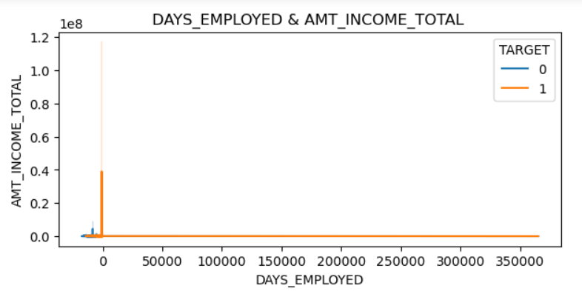
Does employee working days has impact on annual income?
Employee working days has no impact on annual income

Slide 28
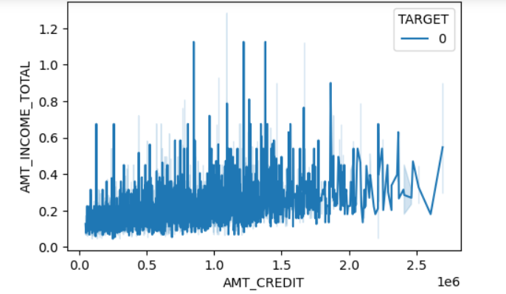
Which applicant can get more CREDIT amount ?
Applicants who owns a home & has car & having less than 2 children , Can get more Credit amount compared to others

Slide 29
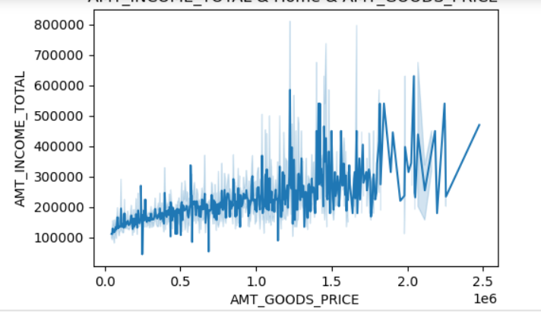
Annual income & goods Price
Applicants whose Loan amount(Goods_price) is less than Annual income has lower probability to become defaulter.

Slide 30
Observations:
Nearly 90000 or 91% applicants have target 0
Nearly 90000 or 90.50% applicants have cash loans
30000+ are male applicants & 60000+ are female applicants
60000+ applicants have no cars & 30000 applicants have cars
60000+ applicants have house & nearly 30000 applicants have no houses.
70000 applicants have 0 children ,20000 applicants have 1 children
81.12% of applicants have unaccomplished while applying for credit card
51.90% of applicants are working income type
71.07% of applicants have secondary/secondary special education type
100% of applicants have provided mobile number

Slide 31
82.13% of applicants have provided WORK PHONE number
80.03% of applicants have No PHONE at home
99.80% of applicants mobile is Reachable
94.38% of applicants have not provided email
26.14% of applicants having occupation laborers.
87.86% of applicants have submitted documents
5% of applicants have applied on sunday,10-17% of application for credit card comes in rest of days.
51.72% of applicants having family member 2.
Most of the applicants have AMT_GOODS_PRICE 0.5
Most of the applicants have DAYS_EMPLOYED between 2500 to 0

Slide 32
Applicants who have low probability to be defaulter(Bank should approve loan)
Male Applicant whose Average Annual Income is 195035 and female is 155897 has low probability to become defaulter
Applicants having 0 children
Applicants having cash loans
Applicants who owns car & having average income of 197255 has lower probability to become defaulter
Applicants who owns house
Applicants who are having income type as Working & Commercial associate & Pensioner
Applicants who Education type is secondary/secondary special & Higher Education
Applicant whose education type is Higher education & having Average Annual Income of 209378

Slide 33
Applicants whose family status is Married
Applicants who has provided mobile number, Email, Work & Home phone numbers.
Applicant whose Mobile is Reachable
Applicant whose Average AMT_GOODS_PRICE is 542764
Applicant whose Average AMT_CREDIT is 602729
Annual Income should be greater than loan amount

Slide 34
Applicant who is going to defaulter (Bank Should disapprove loan)
Applicant whose annual income is less than Credit Amount and amount goods price
Applicants having more than 1 children have high probability to become defaulter
Applicants having Revolving Loans have high probability to become defaulter
Applicants who doesn't owns car and House and mobile
Applicants whose family status is not married
Applicants who doesn’t Provide mobile number , Home & work phone number
Applicants who doesn’t provide email
Applicant whose phone is not reachable

Slide 35
Credit amount those Applicants who owns a home & has car & less than 2 children can increased or it can more compared to others
Applicants who doesn't have income type as Working & Commercial associate & Pensioner
Applicants who doesn’t have Education type as secondary/secondary special & Higher Education
Applicant who doesn’t have education type as Higher education has probability to become defaulter.

Slide 36

Thank You

